Slide 1

DM Chap. 1a - DIKW
Prof. Dr. Markus Grüne
Bild: Prof. Dr. Markus Grüne, © 2024

Slide 2
Learning Goals
Learning Goals
Background
→ Understand the meaning and difference between Data, Information, Knowledge and Wisdom.
→ Understand the application of the DIKW pyramid in North‘s knowledge-based management concept.
→ It is important to distinguish between Data, Information and Wisdom as they are treated by different systems.

Slide 3

Considering "Data"
Data are
defined as symbols that represent properties of objects, events ...
the products of observation.
are of no use until they are in a useable (i.e. relevant) form.
The difference between data and information is functional, not structural.
Data is based on characters on which a language-specific syntax is applied.
Image: Prof. Dr. Markus Grüne © 2024; Córdoba, Brazil
Notes:
Is money data?

Slide 4
Data
Data can be sometimes be represented in tabular format.
Columns have a specific Data Type / Domain.
Signs are used for the creation of values, e.g., characters and figures.
We can sometimes test whether data is valid by checking a data item against its Data Type.
Data needs to be documented, e.g., in a Data Dictionary.
Domains
Table for "PERSON"
Data Type | Integer / Key | char(20)
Attribute Name | ID | NAME
entity 1 | 1 | Meier
entity 2 | 2 | Amir
… | … | …
Tuples, objects, entities
Values

Slide 5
Data Models
view 1
view 2
…
view n
Data Models are used on different levels:
Communication between Business and IT Stakeholder → Conceptual Models
Definition of the logical structure of a Database → Logical Models
Definition of the internal structure (internal organization such as memory allocation) of a Database → physical / internal model
conceptual schema
logical schema
internal schema
The ANSI-SPARC Model

Slide 6
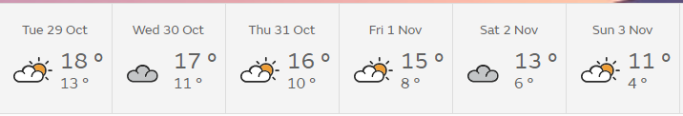
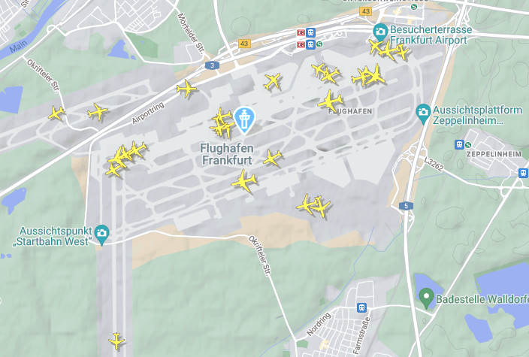
Information
When assigned a meaning (semantics), data becomes information.
Information is contained in descriptions, answers to questions that begin with such words as who, what, when and how many.
Information systems generate, store, retrieve and process data. Information is inferred from data.
weather forecast for Frankfurt (Germany) by Met Office, UK
Aircraft around Fft Int'l Airport by flightradar24 ©

Slide 7
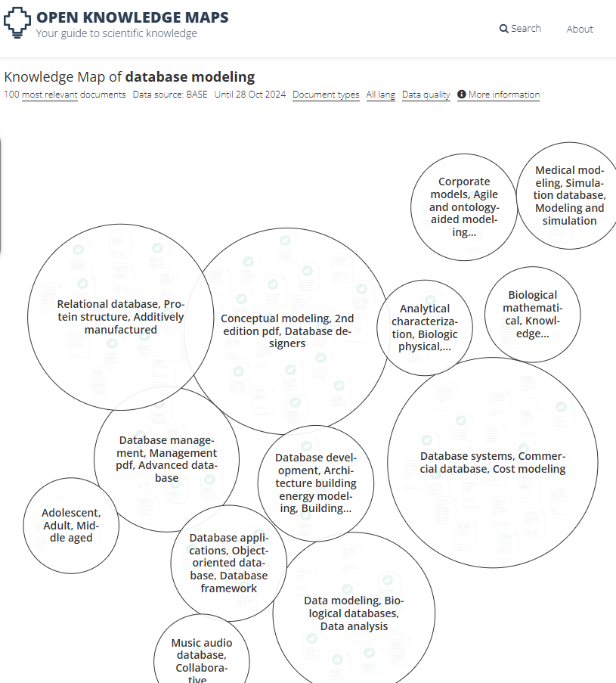
Knowledge, Intelligence, Wisdom
Knowledge
different information that is in a context is linked to one another.
transformation of information into instructions.
can be obtained by instruction, or by extracting it from experience.
is the totality of the skills and abilities individuals use to solve problems.
is related to people.
Intelligence can be seen as the ability to increase efficiency → Business Intelligence / Artificial intelligence
Wisdom adds value, which requires the mental function that we call judgement. The ethical and aesthetic values that this implies are inherent to the actor and are unique and personal.
Created with https://openknowledgemaps.org/
Notes:
Question: does the image really reflect knowledge?

Slide 8
All in one Picture – DIKW Pyramid
Data: discrete, objective facts on objects and events
Information: interchanged by messages and meant to change the receiver's perception
Knowledge: values, experience, can be applied to messages. Setting into context.
Wisdom: "wise", values behind actions
Information
Data
Knowledge
Wisdom
Ackoff, R. L. (1989). “From Data to Wisdom.” Journal of Applied Systems Analysis, Vol. 16, No. 1: pp. 3-9.
Notes:
Each layers builds on the lower layers. There is no information without data, no knowledge without information ...

Slide 9
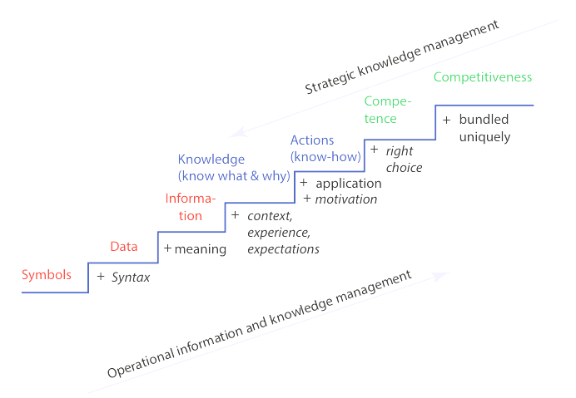
Homework
Download the following book, which you can access throught the University's VPN:
North, Klaus; Kumta, Gita (2018): Knowledge management. Value creation through organizational learning. Second edition. Cham: Springer (Springer texts in business and economics).
https://link.springer.com/book/10.1007/978-3-319-59978-6
Answer the following question w.r.t. the book:
What is Knowledge Management? What is strategic and what operational Knowledge Management?
Describe the Knowledge Ladder given in Fig. 2.1, p. 35.
North / Kumta (2018) Fig. 2.1, p. 35.

Slide 10

Recap
Data, Information
North / Kumta – Knowledge
Data and Information are both sides of the same medal. Data are, e.g., bits and bytes that reside on disks and need to be interpreted as Information.
North and Kumta describe, how knowledge needs to be handled in a company to create competitive advantage.
DIKW
Side note
The DIKW Pyramid is an early model to explain the interlinkage between Data, Information, Knowledge, Wisdom. Data is the basis for all other concepts.
You should be able to explain the difference between each of the concepts.

Slide 11
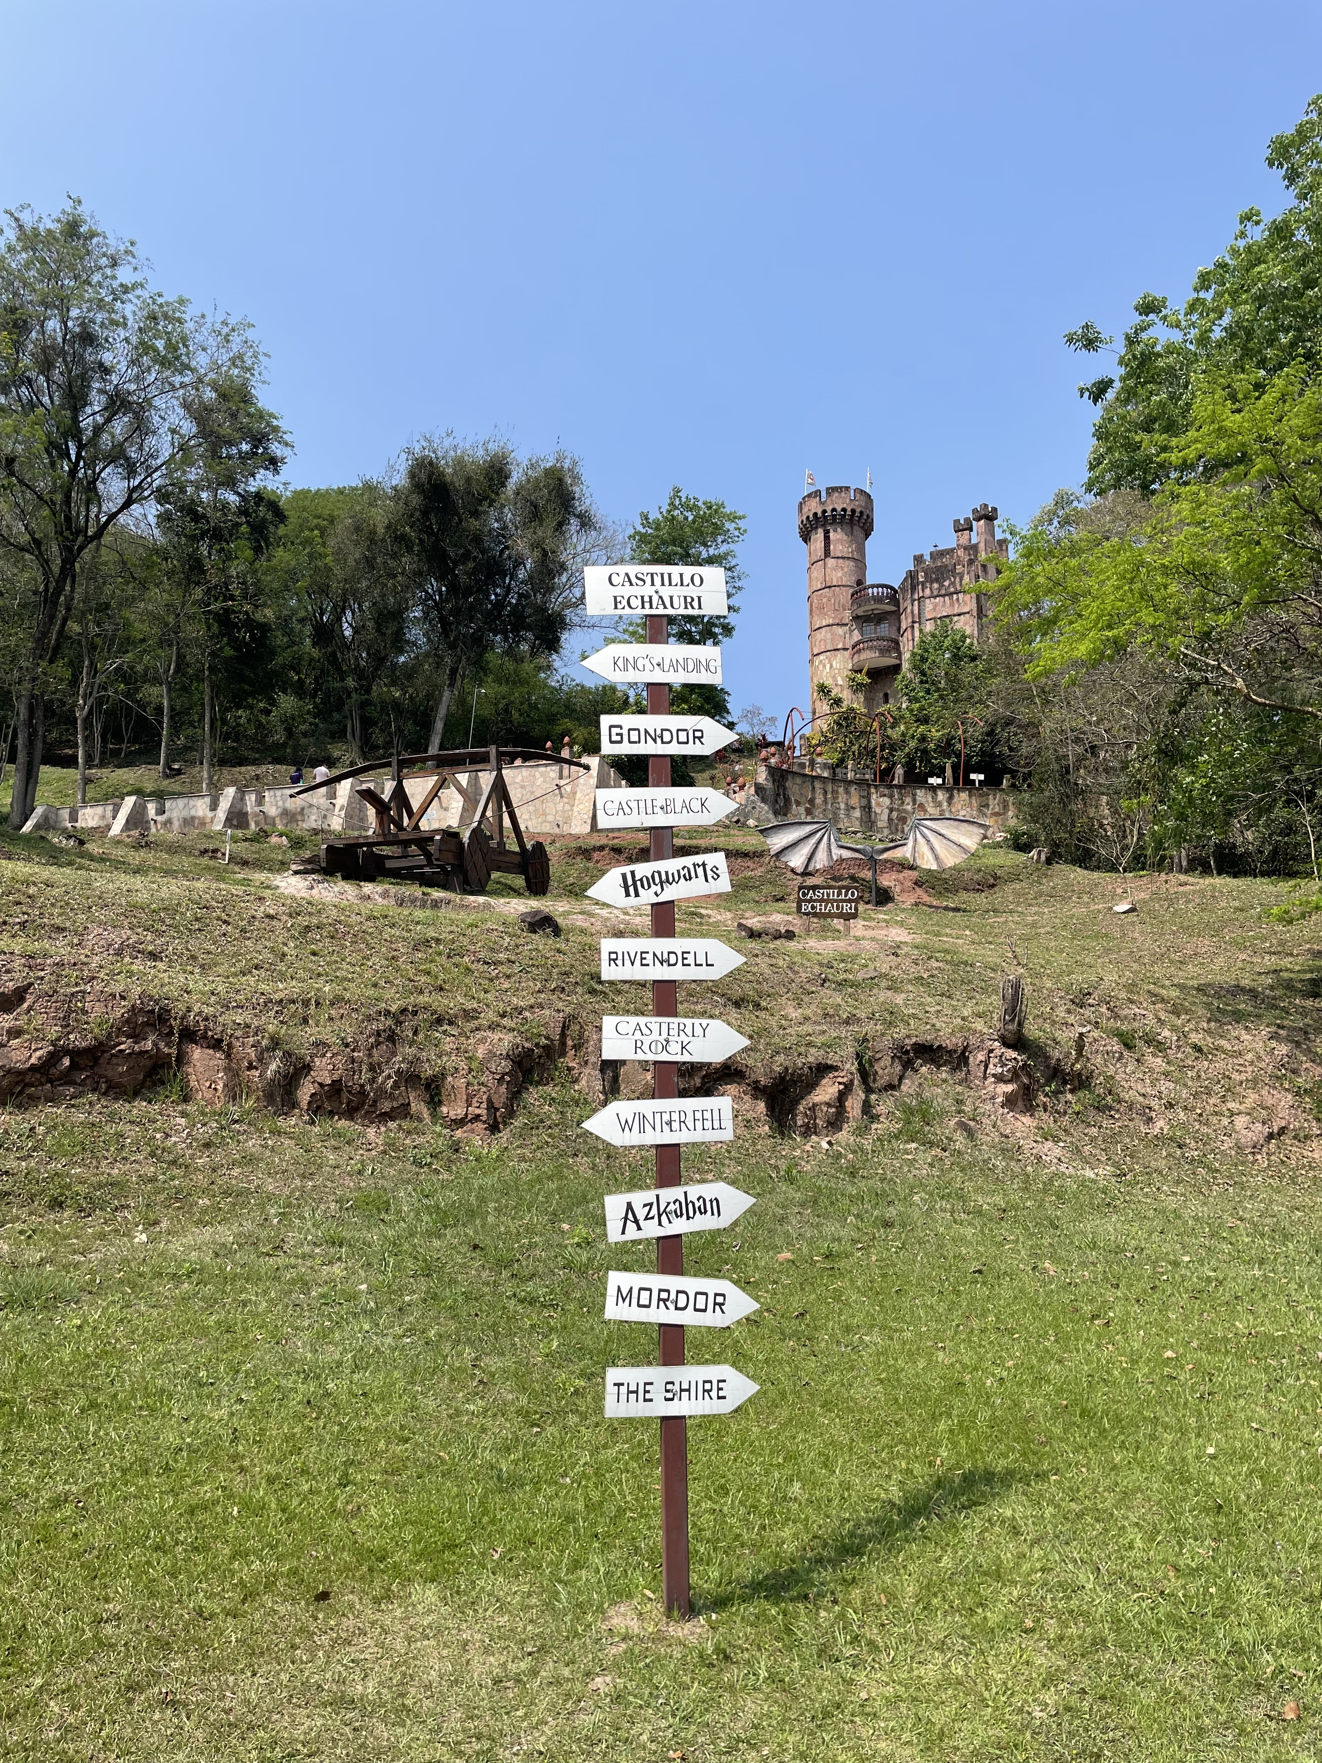
Literature
Ackoff, R. L. (1989). “From Data to Wisdom.” Journal of Applied Systems Analysis, Vol. 16, No. 1: pp. 3-9.
North, Klaus; Kumta, Gita (2018): Knowledge management. Value creation through organizational learning. Second edition. Cham: Springer (Springer texts in business and economics).
Source: Prof. Dr. Markus Grüne, © 2024; Castillo Echauri, Paraguay

